Slide 1
FUNDAMENTALS OF DATASCIENCE USING R PROJECT REVIEW
Department of Artificial Intelligence and Data Science
Academic Year: 2024 – 2025 (Even Semester)
Register Number : SAI NITHICK ROSHAAN S
Name : 2303811724321094
Year : II
Semester : IV
Section : B
Date : 02.06.2025

Slide 2
TITLE OF THE PROJECT
Predicting Scores Based on Study Hours Using Linear Regression

Slide 3
PROBLEM IDENTIFIED
Students often struggle to estimate the required study hours for desired scores.
Manual prediction of performance is inaccurate and time-consuming.
There is no simple tool to visualize the relationship between study hours and scores.
A lack of automated prediction systems affects planning and motivation.

Slide 4
OBJECTIVE
To develop a Shiny app that predicts student scores based on study hours using
linear regression.
To provide an interactive interface for users to input study hours and view predicted results.
To visualize the relationship between study hours and scores through dynamic plots.

Slide 5
R PROGRAMMING & ML CONCEPTS
R is used to build an interactive web application using the Shiny framework.
CSV file input is handled in R to read and preprocess student data.
A linear regression model is implemented in R to learn the relationship between study hours and scores.
Predictions are made using the trained ML model based on user input.
ggplot2 in R is used to visualize actual data points and predicted trends interactively.

Slide 6
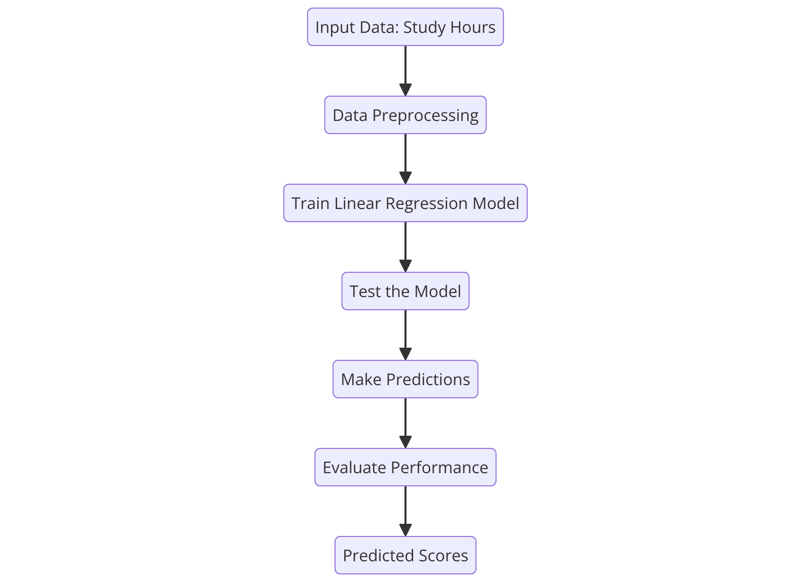
PROPOSED ARCHITECTURE

Slide 7
MODULE DESCRIPTION
Data Collection & Preprocessing:
Collect and clean the student study hours and scores data to ensure accuracy for modeling.
Model Building (Linear Regression):
Develop a linear regression model to capture the relationship between study hours and scores.
Model Evaluation & Prediction:
Assess the model’s performance and use it to predict scores for given study hours.
Visualization:
Create dynamic plots to visualize the actual data, regression line, and predicted scores interactively.

Slide 8
MODULE IMPLEMENTATION
1. Data Collection & Preprocessing
Gather student data containing study hours and scores in CSV format.
Validate data to ensure necessary columns and remove any missing or inconsistent entries.
Prepare data for modeling by structuring it in an appropriate format for analysis.
2. Model Building (Linear Regression)
trainModeUse the cleaned dataset to train a linear regression model predicting scores from study hours.
Fit the model to find the best linear relationship between input ,output variables.

Slide 9
MODULE IMPLEMENTATION
3. Model Evaluation & Prediction
Evaluate the model’s accuracy by checking how well it fits the training data.
Use the trained model to predict student scores based on new study hour inputs.
4. Visualization
Plot the original study hours vs. scores data points for clear insight.
Display the regression line representing the model’s fit on the data.
Highlight predicted scores on the plot based on user input for easy interpretation.

Slide 10
SOURCE CODE
# Train the linear model
model <- lm(Scores ~ Study_Hours, data = data())
# Create new input data for prediction
new_data <- data.frame(Study_Hours = input$input_hours)

Slide 11
SOURCE CODE
# Predict the score
predicted_score <- predict(model, newdata = new_data)
# Output predicted score
output$predicted_score <- renderText({
paste0("📊 Predicted score for ", input$input_hours, " hours of study is: ", round(predicted_score, 2))
})

Slide 12
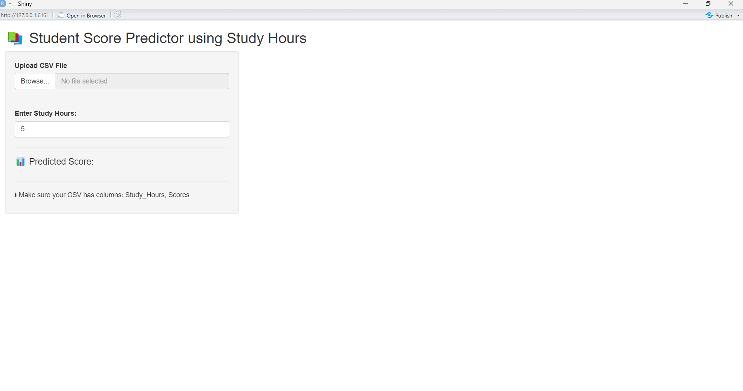
OUTPUT

Slide 13
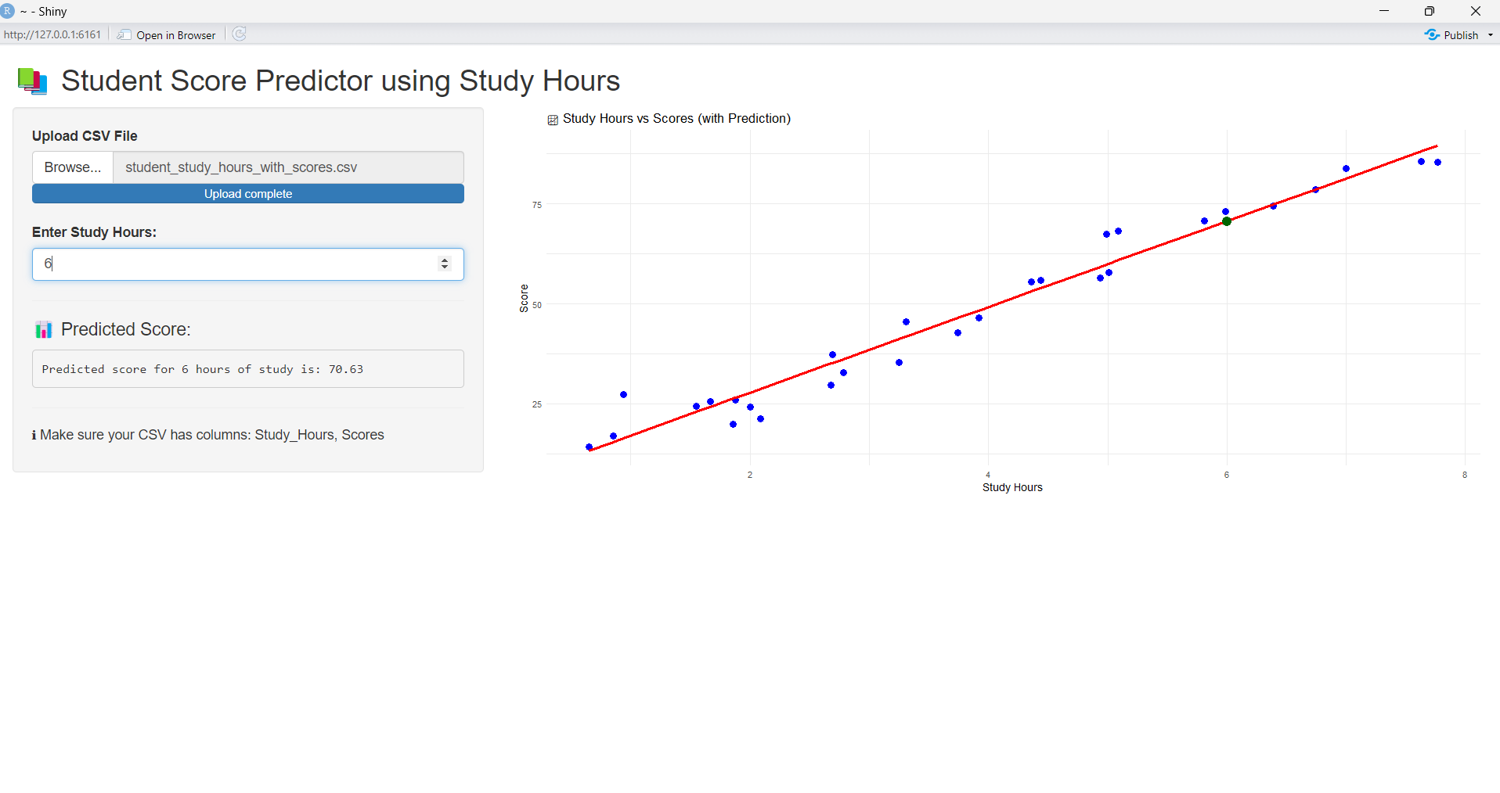
OUTPUT

Slide 14
CONCLUSION & FUTURE SCOPE
The The system accurately predicts student scores based on study hours using a linear regression model.
It provides an interactive interface that helps students plan and improve their study habits effectively.
Future Scope
Integrate larger and more diverse datasets to enhance model accuracy and reliability.
Include additional factors like attendance and study methods for better prediction insights.

Slide 15
Thank You
Any queries???

